Slide 1
Locating the best place to open a restaurant or hotel in Hamburg
Roman Leittersdorf - 2020

Slide 2
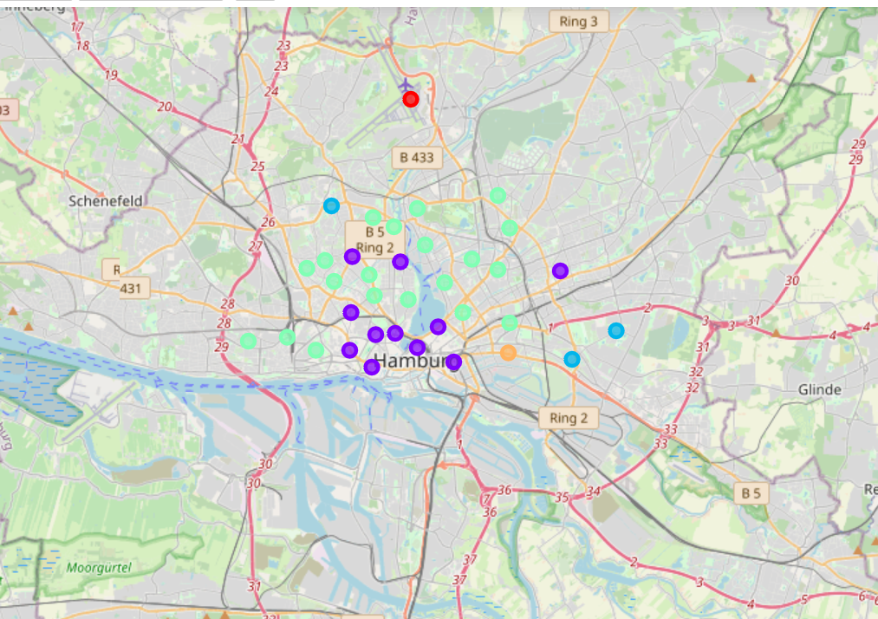
Cluster analysis

Slide 3
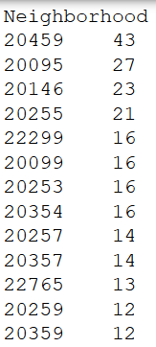
Districts with most restaurants

Slide 4
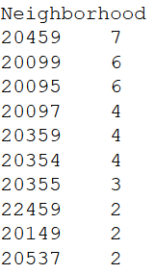
Districts with most hotels

Slide 5
Conclusion
Most restaurants and most hotels in Hamburg are in the area with Postal Code 20459. In this area the “Portugiesenviertel” (Portuguese district) is located with many Portuguese restaurants.

